Slide 1


-P2P2P-
“PlusCal to PlantUML to PDF”
Making Formal Methods Explainable
Juan José Serrano (presenter), Alejandro Benito, Jackson Belzer and Christian Lamb
TLA+ Community Event @ ETAPS 2026
Notes:
"Hello everyone, and thank you taking the time to join me today. My name is Juan José Serrano, and it is a distinct privilege to be here speaking at the TLA+ Community Event at ETAPS 2026. Today I am presenting a project we call P2P2P. The acronym stands for 'PlusCal to PlantUML to PDF'. I developed this robust toolchain alongside my exceptional colleagues Alejandro Benito, Jackson Belzer, and Christian Lamb. Our core mission with this project is simple to state, but mathematically and architecturally complex to achieve: We are making formal methods explainable, accessible, and ultimately, universally verifiable for engineering teams around the globe."

Slide 2
Table of contents
01
02
03
04
05
06
Problem
Solution
Transformation
Impact
Architecture
Closing
Notes:
"Over the next thirty minutes, I intend to take you on a detailed journey under the hood of this technology. First, I will walk you through the core, systemic problem we identified in the software industry regarding formal documentation. Second, I will introduce our automated pipeline solution. Third, and most importantly for this audience, we will dive deeply into the Transformation phase—how we actually parse mathematical syntax into an Abstract Syntax Tree and map it to declarative diagrams. After that, we'll discuss the measurable impact this brings to enterprise engineering teams, look comprehensively at our Rust-based compilation architecture, and conclude with the future roadmap of this project."

Slide 3

01
Problem
Notes:
"Let's begin by contextualizing the fundamental problem we are trying to solve."

Slide 4
The Problem
Formal methods are powerful… but hard to communicate
Engineers -> code
Stakeholders -> Visuals
Formal models -> in between
Notes:
"We are all here today because we collectively acknowledge that formal methods—specifically TLA+ and its algorithmic counterpart, PlusCal—are incredibly, perhaps uniquely, powerful for designing and verifying complex, concurrent distributed systems. They allow us to mathematically guarantee that our architecture is free from deadlocks, race conditions, and fundamental logic flaws.
However, despite this immense power, TLA+ suffers from a critical bottleneck limiting its enterprise adoption: the models are notoriously hard to communicate. In a typical software organization, you have a divide. Your software engineers and developers live in imperative, conventional code. Your stakeholders, business analysts, and product managers live predominantly in visual artifacts—in architectural diagrams, flowcharts, and sequence models. The formal models sitting in the middle, unfortunately, remain understood by only a very small, specialized subset of verification engineers. This creates an isolated silo where the most mathematically sound parts of the system are the least understood by the wider team."

Slide 5
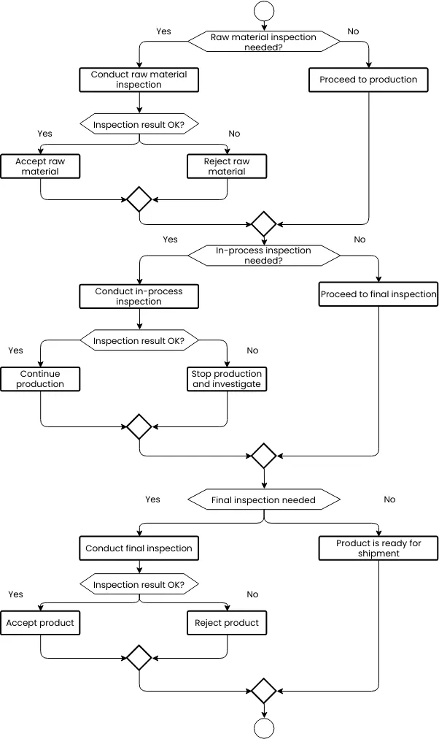
Diagrams Are the Bottleneck
Manual & Slow
Quickly Outdated
Not Trustworthy
Notes:
"Traditionally, to bridge this communication gap between the mathematicians and the managers, engineering teams rely on drawing visual diagrams. But here lies a massive point of friction. Hand-drawing UML, state machines, or sequence diagrams using tools like Visio or Lucidchart is highly manual and incredibly slow. Worse still, modern software code evolves rapidly—sometimes daily or hourly. The very moment the underlying code or the formal specification changes, those hand-drawn diagrams instantly become outdated. And as any software engineer will tell you, when architectural documentation is outdated, it is no longer just unhelpful; it becomes dangerously misleading. It ceases to be documentation and instead transforms into technical debt."

Slide 6
SanDisk Current Workflow
01
02
03
04
05
English Specs
UML Diagrams
Reviews
Verification
PDF
Notes:
"To ground this in reality, let us examine the current documentation workflow at major hardware and software corporations, such as SanDisk, whose workflows heavily inspired our friction analysis.
The process usually begins with writing extensive English-language specifications—often hundreds of pages long and inherently ambiguous. Next, system architects spend weeks manually drafting UML Diagrams based off their interpretation of that English. Then, there are prolonged manual review processes where teams argue over semantics. Only *after* all of this administrative overhead do the specialized verification engineers step in to write the actual mathematical verification models in TLA+. This process is highly disconnected, inherently prone to translation errors, and the feedback cycles are agonizingly slow. The diagrams have no mathematical connection to the code. They are merely a human being's best guess."

Slide 7
Manual Reviews Risk
Manual Diagrams ≠ Verified Logic
Hand-crafted diagrams
Verification not enforced
Risk of hidden errors
Notes:
"The most dangerous risk native to this workflow is the false sense of security it provides. Manual diagrams do not equal verified logic. When a human architect hand-crafts a sequence diagram, verification is absolutely not enforced on that visual output. What the project stakeholder is seeing on the screen is not necessarily the same constraint that the TLC model checker is actually verifying in the backend. This disconnect introduces a massive, critical risk of hidden systemic errors entering production, simply because the colorful picture the team agreed upon does not fundamentally match the rigorous mathematics driving the system."

Slide 8
What if documentation came directly from
verified models?
Notes:
"So, looking at this severely broken and inefficient pipeline, our team asked a provocative question: What if documentation didn't need to be drawn by hand anymore? What if flawless, perfectly accurate architectural documentation could be generated *directly*, automatically, and instantly from the verified mathematical models themselves?"

Slide 9

02
Solution
Notes:
"That exact question led us directly to the creation of our solution."

Slide 10
P2P2P Pipeline Overview
01
02
03
04
PlusCal
PlantUML
PDF
Your Team/Client :D
Notes:
"This brings us to the core of this presentation: the P2P2P pipeline. We created an automated compiler toolchain that acts as an unbreakable bridge. It takes your formally verified PlusCal mathematical models, parsing them automatically to convert them into declarative PlantUML text representing diagrams. But we don't stop there. The toolchain then orchestrates those PlantUML visuals, pairs them with the originating source code, and compiles them into a highly professional, human-readable LaTeX PDF. This final artifact is immediately ready to be handed off to your development team or your client, with zero drafting or drawing ever required by an engineer."

Slide 11
What It Does
VSCode Integration
Automatic Diagram Generation
Professional PDFs
Notes:
"To maximize adoption and completely reduce developer friction, we ensured our tool integrates directly into the developer's native working environment. We deliver this power via a seamless VSCode extension. With a single click of a button, or via a simple keyboard shortcut, it triggers the entire workflow in the background: TLC model checking, automatic AST parsing, diagram generation, and LaTeX PDF compilation. It delivers professional-grade documentation of your verified logic without you ever having to leave your code editor."

Slide 12
Key Idea
Making formal methods social
Shared understanding
Math
Visual
Notes:
"The foundational philosophy driving this architecture is what we like to call 'Making formal methods social'. TLA+ should not just be an obscure language reserved for the verification engineers hiding in a basement laboratory. By translating rigorous mathematical state transitions into accessible, readable visuals, we are actively creating a shared vernacular—a shared understanding across the entire corporate organization. We want the Product Manager, the QA tester, and the junior front-end developer to be able to look at a PDF and intuitively understand the state machine constraints that the formal engineer just spent three weeks proving."

Slide 13
Value of the Solution
Key benefits
01
02
03
Time and effort savings
100% accurate diagrams consistent with verification
Encourages adoption of formal methods (PlusCal and TLA+)
Notes:
"The enterprise value proposition of P2P2P stands on three major pillars.
First, we are delivering immense time and effort savings to the business. Engineers will never need to manually draw, update, or debug an architecture diagram ever again.
Second, we deliver absolute certainty. You are guaranteed 100% accurate diagrams that are mathematically and structurally consistent with your verification constraints.
And third, perhaps most importantly for this community, by dramatically lowering the learning curve and improving the visibility of formal methods, our tool actively encourages the wider adoption of TLA+ and PlusCal in companies that might otherwise be intimidated by the academic overhead."

Slide 14
Core Principle
If it’s not verified,
it doesn’t get documented
Notes:
"All of this engineering effort is anchored by one strict, uncompromising core principle in our design philosophy: If it’s not verified, it doesn’t get documented. Our compilation pipeline strictly enforces a successful TLC verification phase before a single line of visual PlantUML is ever generated. We absolutely refuse to generate diagrams for broken specifications."

Slide 15

03
Transformation
Notes:
"Now, let's pull back the curtain and dive deep into the technical core of the transformation pipeline. How do we actually turn mathematical syntax into visual artifacts?" *(Note: Slow down your pace significantly here. Emphasize the technical depth to appeal to the academics and software engineers embedded in the ETAPS audience).*

Slide 16
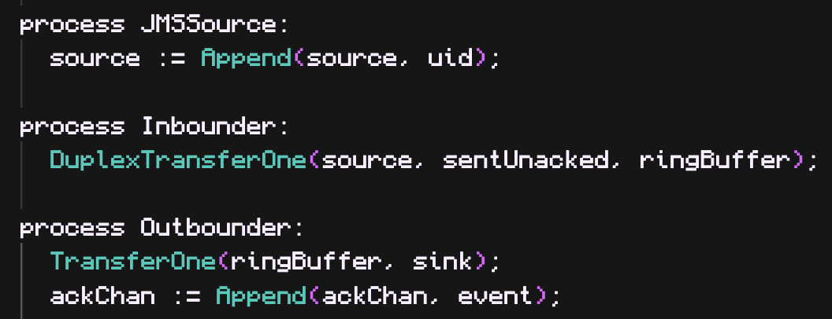
PlusCal Model
3 processes + shared queues
Notes:
"Let's look at a concrete PlusCal Model to ground our demonstration. In this specific example on the screen, we have modeled a system featuring three concurrent processes operating asynchronously over shared communication queues. This is standard, verified PlusCal code that many of you in this room are intimately familiar with."

Slide 17
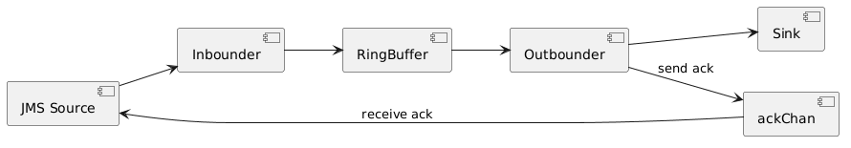
System Structure
Notes:
"From a purely abstract viewpoint, here is a high-level representation of what that system structure looks like. We have producers generating data, consumers retrieving data, and strict constraints handling the complex network traffic safely between them."

Slide 18
Key Semantics
Message ordering
Bounded buffer (RingBufSz)
Acknowledgment correctness
Notes:
"For this specific system model, the key operational semantics we care about proving to ensure safety are threefold. One: strict message ordering must be maintained. Two: adhering completely to a bounded buffer size, represented here as the `RingBufSz` constant, preventing memory overflow. And three: ensuring total acknowledgment correctness without the possibility of message duplication."

Slide 19
Verification (TLC)
Config
Properties
Model Checking:
RingBufSz = 16
State constraint:
Len(source) < 11
Len(sink) < 13
Assertions:
ack = inmsg
No duplicate acks
sink[i] = i (ordering)
Notes:
"As I emphasized earlier, before we draw a single pixel or line of documentation, we invoke the TLC model checker. We verify the configuration, the state constraints—like ensuring the size of the source and sink buffers never exceed their initialized limits—and the explicit assertions, such as guaranteeing that acknowledgments map perfectly to input messages.
If the TLC model checker fails at this stage, the entire P2P2P pipeline throws a hard exception and halts. The software will alert the developer immediately. The architectural diagrams are only permitted to be generated if the model is mathematically proven to be safe."

Slide 20
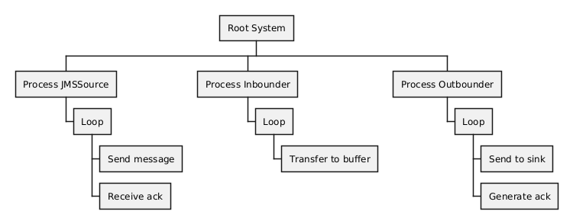
Model Structure (AST)
Extracted from TLA+ model
Notes:
"Once the TLC verification successfully passes, our real work begins. We need to extract the Abstract Syntax Tree, or AST, directly from the underlying TLA+ logic. To accomplish this, we leverage the standard `pcal.trans` compilation tool to parse the algorithmic PlusCal into raw TLA+. This process yields an incredibly detailed AST tree structure in JSON format that our custom Rust compiler can systematically ingest, traverse, and analyze."

Slide 21
Mapping to UML
PlusCal | Diagram
process | swimlane
while | loop
await | guard
Notes:
"Our custom Rust algorithm then begins a recursive mapping process, translating these raw AST nodes into highly specific UML diagram concepts.
For instance, when generating Sequence Diagrams, our compiler analyzes the AST looking for a PlusCal `process` definition. It maps that node directly into a PlantUML `swimlane`.
When evaluating concurrency and repetition, a `while` statement parsed from the AST is mapped natively into an encapsulated `loop` boundary box within the sequence execution.
Similarly, an `await` statement is carefully intercepted and translated into a state `guard` visually over the transition lines.
For our Predicate-Action diagrams, we had to be incredibly mathematically precise. We strictly follow Leslie Lamport's formal 'TLA in Pictures' dissertation. In our implementation, simulated AST state mutations become the literal State Predicate nodes in PlantUML, and the explicit `pc` (program counter) labels become the Action edges connecting those states. We do not place conditionals on the edges; we adhere purely to the mathematical definition that an edge represents an indivisible action."

Slide 22
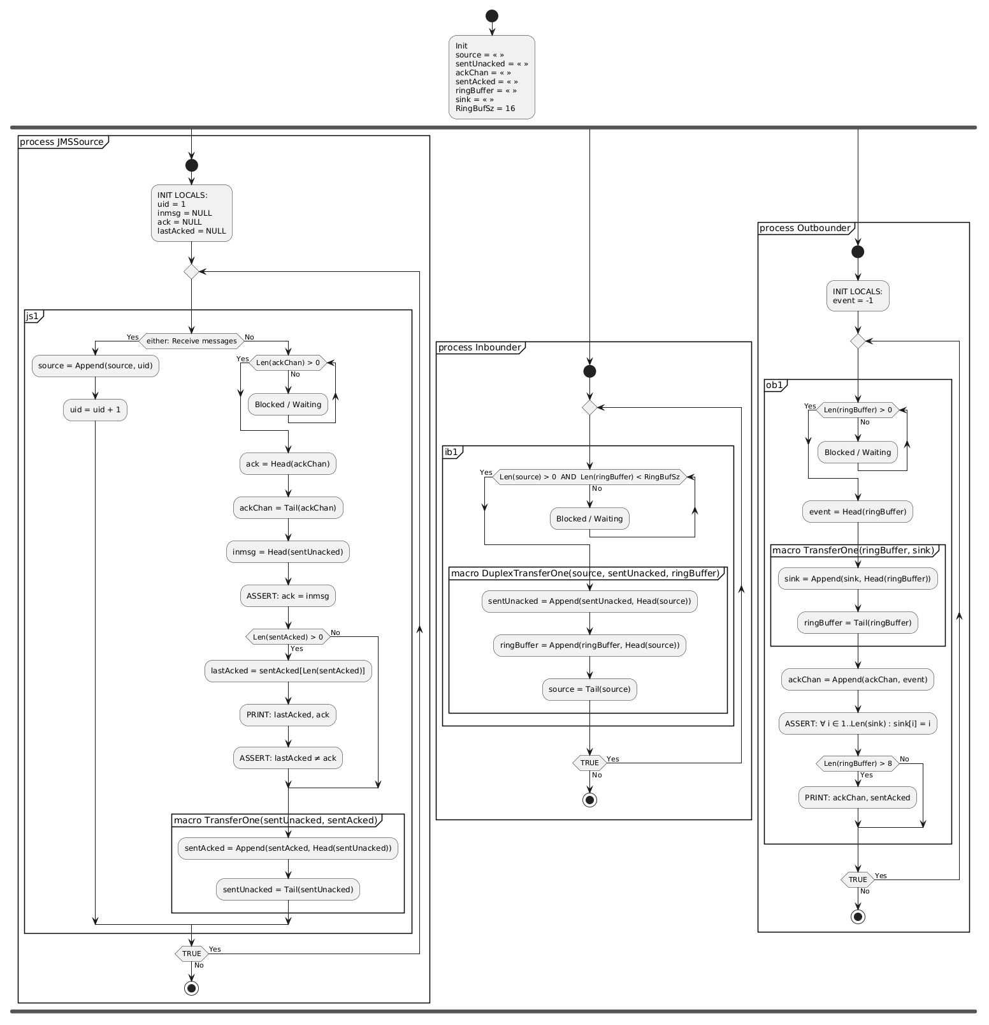
Generated Diagram
Notes:
"And here on the screen is the final result of that AST traversal. What you are looking at is a fully generated, programmatically accurate representation of the system flow. It is natively rendered in PlantUML by our Rust engine, heavily formatted to be clear, strictly aesthetic, and immediately readable."

Slide 23
What you see
= What was verified
Notes:
"I want to pause here to emphasize a critical point. Because this specific visual diagram is synthesized programmatically and directly from the exact same simulated AST that was passed to the TLC model checker... what you see on the screen is exactly what TLC just verified. Let me repeat that: There are no semantic translation errors. There are no humanly missed connections. We have removed human error from architectural documentation entirely."

Slide 24
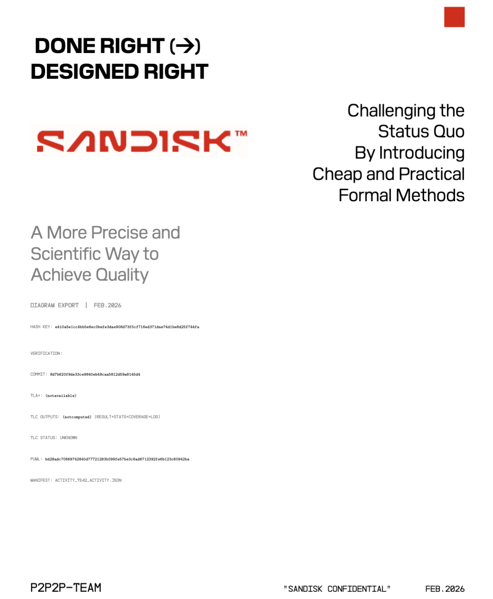
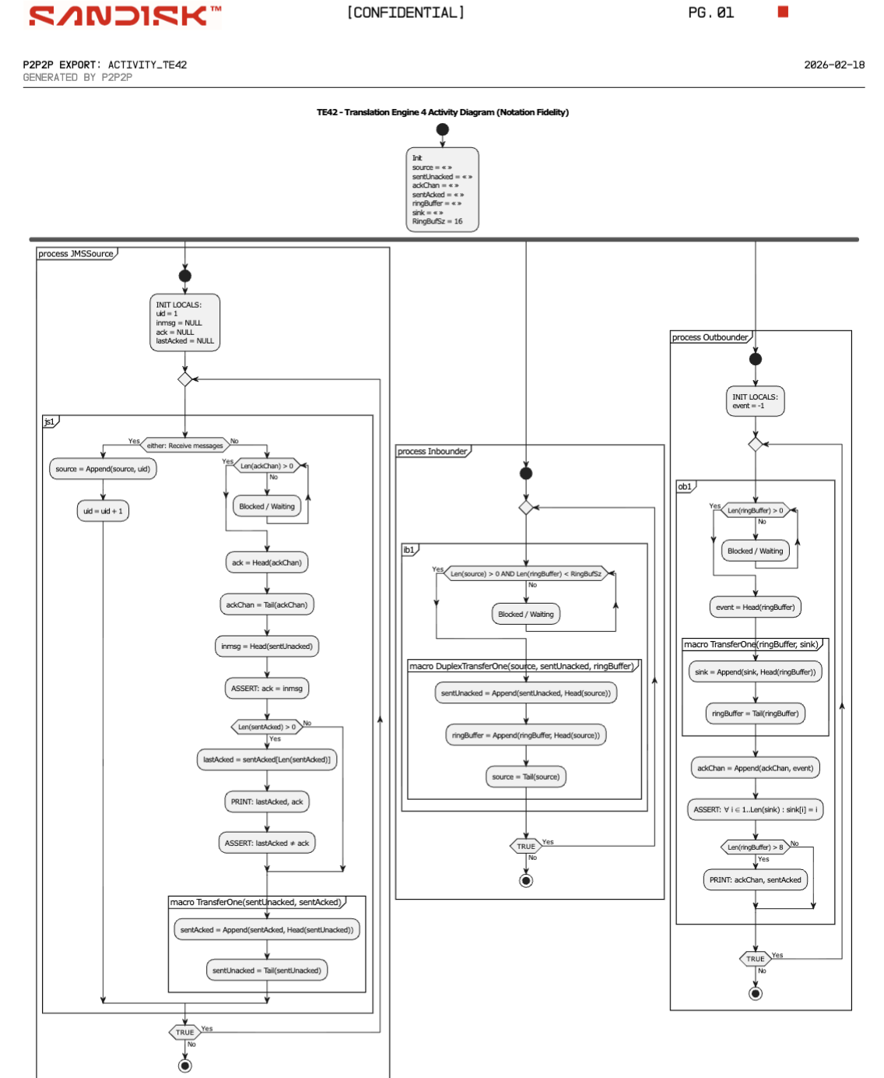
PDF Output
Notes:
"Once the PlantUML texts are generated, we don't just leave the user with raw diagram code. We automatically wrap this PlantUML output into a cleanly formatted, beautifully typeset LaTeX PDF document. We chose LaTeX specifically because it provides the uncompromising standard of typographical professionalism that is expected in academic paper publications, aerospace corporations, and strict engineering environments."

Slide 25
Supported Diagrams
Activity
Sequence
Predicate-Action
Notes:
"Currently, the P2P2P compiler officially supports three fundamental diagram paradigms to capture different angles of concurrency. We support Activity diagrams to graph high-level algorithmic control flow. We support Sequence diagrams to beautifully illustrate asynchronous, concurrent message passing between processes. And finally, we support Lamport-style Predicate-Action diagrams to provide the most rigorous, state-transition mathematical representations of your architecture."

Slide 26
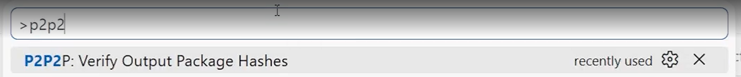
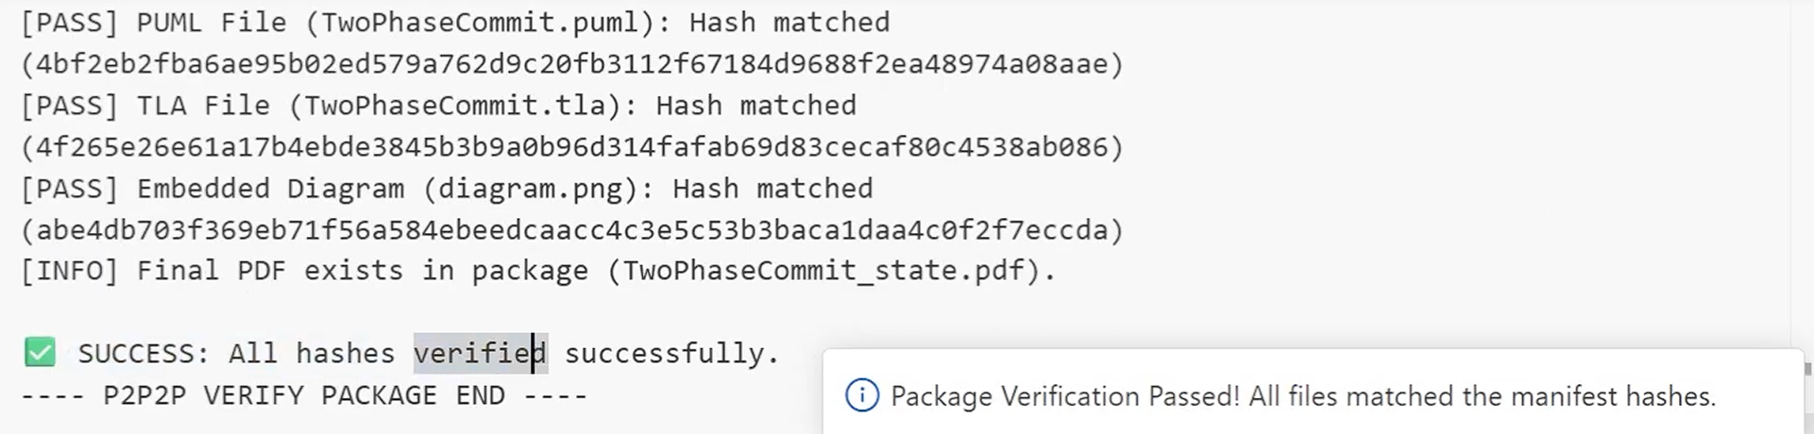
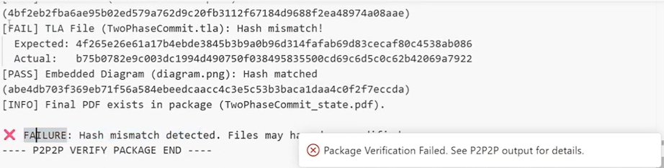
Hashing
Notes:
Next, we show how hashing works in our system and how we use it for verification.
We take a file and run it through a SHA-256 hash function. This gives you a fixed-length value that acts as each file’s fingerprint. If the file changes, even by one character, the hash changes.
During verification, you recompute the hash for each file and compare it to the value stored in the hash manifest.
• If the hashes match, the file is unchanged
• If one hash does not match, the package fails verification
In the bottom example, you can see a mismatch. The tool shows both the expected hash and the actual hash, so you can clearly see the difference.
For example, changing one line in a file produces a completely different hash. That makes it easy to detect any changes.

Slide 27
Living Documentation
Always updated
Always verified
Always consistent
Notes:
"When you deploy this pipeline locally, it establishes what we call a state of Living Documentation. It is always updated, always verified, and always mathematically consistent. If a backend engineer changes a threshold variable in the PlusCal code, they simply save the file, and they are immediately presented with a new, strictly correct architecture PDF instantly. Documentation is no longer an afterthought; it is a live reflection of reality."

Slide 28
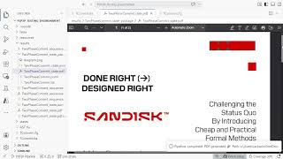
Live Demo
Insert Demo Video
Notes:
"To really showcase the speed and power of this toolchain, let me walk you through exactly what this looks like in practice with a live unedited demonstration."
*(At this point, talk slowly through your video. Describe exactly what is happening in the VSCode extension. Point out the length of the `.tla` file. Show where you make a specific edit to the logic block. Show the user running the P2P2P compiler command. Verbally narrate the terminal output as it passes the TLC verification. Finally, narrate the appearance of the output LaTeX PDF and highlight how beautifully structured the automatically generated diagram is. Spend at least 3 to 4 full minutes on this slide narrating every action).*

Slide 29

04
Impact
Notes:
"So, we have demonstrated the tool and its technical capabilities. But what is the real-world, measurable impact on the software development lifecycle?"

Slide 30
Team Impact
Faster Reviews
Less
Manual Work
Fewer inconsistencies
Notes:
"At a practical team level, the immediate impact is that it enables dramatically faster, far more comprehensive code reviews. Reviewers—who perhaps are not TLA+ experts themselves—can now look at the automatically generated PDF sequence diagram to visually trace and intuitively understand the concurrency model, rather than attempting to mentally parse and simulate 500 lines of complex PlusCal syntax in their heads. It drastically reduces, if not completely eliminates, the manual administrative busywork of drafting visio charts, and entirely closes the gap of inconsistencies between disparate system specifications and the final documentation."

Slide 31
Methods Impact
Lower barrier to TLA+
Better communication
Notes:
"Looking broadly outward into the industry, we strongly believe this tool fundamentally lowers the barrier to entry for adopting TLA+. By providing robust, automatic, and highly visual communication tools natively within the development pipeline, internal formal methods advocates inside large corporations can finally prove the immediate value of these tools to their management constraints. We are allowing formal methods engineers to speak the language that management understands: indisputable visuals."

Slide 32
Guarantees
Less than 60 seconds per model
Deterministic outputs
100% accuracy with verified PlusCal
Notes:
"We stand firmly behind this toolchain with an array of enterprise-level guarantees. Firstly, the entire pipeline executes and compiles in less than 60 seconds per model, ensuring developer velocity is maintained. Secondly, the algorithm and its outputs are purely deterministic—the same mathematical inputs will always yield the precise same architectural outputs. And thirdly, we guarantee 100% diagram accuracy strictly tethered to the verified PlusCal source code."

Slide 33
Credibility
Unit Testing
Integration Testing
Usability Testing
Functions in Rust modules (parser, AST, codegen)
Full Pipeline (from TLA+ to PDF)
Visual Studio Code workflow
Tests run continuously during development (CI + pre-demo validation)
Notes:
"To ensure our compiler was robust enough to handle these guarantees, we’ve rigorously established its credibility. We have implemented an extensive suite of unit tests evaluating the logic across all of our Rust parsing and generation library modules. We have sophisticated integration tests assuring that the entire pipeline—from TLA source input all the way to LaTeX PDF output—remains unbroken under edge-case burdens. Furthermore, we conducted usability testing focusing specifically on improving the developer experience within our VSCode extension workflow. These stringent tests run continuously inside of our Continuous Integration environments, endowing us with total, unwavering confidence in the artifacts P2P2P generates."

Slide 34

05
Architecture
Notes:
"For the systems and language architecture engineers in the room with us today, I want to take a few minutes to deeply examine the technical decisions under the hood at our architecture level." *(Note: Continue pacing deliberately here to hit the 25-30 min mark. The technical details of the Rust implementation are incredibly important to ETAPS attendees).*

Slide 35
High-Level Architecture
01
02
03
VS Code Extension
As an user interface
Rust Compiler Pipeline
Orchestrates the compilation of the project and ensures correctness
LaTeX PDF
With AI insertions to document
Notes:
"To achieve these results safely, we consciously decoupled the components and built a strict three-part architecture. The VS Code Extension acts strictly as the graphical user interface, capturing user intent seamlessly and handling local file paths. This extension then orchestrates shell calls to our core Rust Compiler Pipeline executable. The Rust binary is the true heavy lifter of the project—it handles the complex parsing algorithms, the AST tree traversing, and ensuring memory-safe AST transformations. Finally, once the Rust engine achieves its end goal, we integrate standard LaTeX libraries, coupled with some fascinating future plans for AI-assisted heuristic insertions, to beautifully typeset and compile the final PDF document block."

Slide 36
Data Flow
Model.tla
Model.puml generation
Diagram.svg rendered
PASS
TLC Model Checker
Rust Pipeline
TLC Verification Gate
Model.pdf (LaTeX)
FAIL
VSCode Config (Diagram Type)
TLC Fails
Notes:
"Our internal data flow is strictly gated to ensure security and fidelity. The process initiates when a `.tla` model is passed into the external standard TLC Model Checker. This acts as a strict firewall. If TLC fails—for instance, if an arbitrary invariant is unexpectedly violated or a deadlock is reached—the memory pipeline halts the process automatically, refusing to yield a diagram. If, and only if, it passes verification, the Rust Pipeline assumes control. It parses the resulting AST, simulates the algorithm syntactically to synthesize the intermediate `.puml` diagram text artifacts, and ultimately triggers the external `pdflatex` rendering engine to stamp out the final graphical PDF."

Slide 37
Architectural Decisions
Modular Monolith
Modular monolith over microservices
Distributed scaling would add latency, complexity and dependances
Pipeline Dependency Model
Each stage depends only on artifacts from the previous stage
This ensures determinism and traceability
Rust
Backend
Memory safety
High performance
Strong type system
Critical for large AST parsing
Notes:
"We made several very specific architectural logic choices prioritizing sheer performance, maintainability, and absolute memory safety.
First, we consciously chose a Modular Monolith structural approach over a network of fragmented microservices. For local developer environments executing on personal laptops, introducing distributed systems scaling logic would only add dramatically unnecessary latency and extreme dependency complexities.
Second, we strictly enforced a Pipeline Dependency Model. Each individual computing stage in our architecture relies solely and explicitly on output artifacts generated from the stage immediately prior, ensuring absolute deterministic fidelity from start to finish.
And lastly, but perhaps most importantly, we chose to write the entire core compiler backend logic exclusively in Rust. We demanded the memory safety guaranteed by the Rust Borrow Checker, the immense robustness of its strong type system, and the remarkable computing performance advantages Rust provides when recursively traversing, simulating, and mutating massive JSON-formatted Abstract Syntax Trees in real-time."

Slide 38

06
Closing
Notes:
"Finally, to conclude our presentation today..."

Slide 39
Formal methods are only useful
if people understand them
Notes:
"I want to leave you with this foundational perspective: Ultimately, formal methods are a masterclass tool in software verification. But practically speaking, they are only as useful to an organization as the ability of the people building the overarching system to truly understand them."

Slide 40
Future Work
More diagram types
Better customization
Wider adoption
Notes:
"Looking ahead to the upcoming year, our future roadmap for P2P2P is expansive. We are committed to heavily involving the community in adding support for far more diagram types. We are focusing on providing better, much more granular stylistic customization options for the visual outputs specifically matching corporate company guidelines, and fundamentally pushing our open-source integration forward for wider, mainstream adoption within large corporate and enterprise engineering divisions globally."

Slide 41
TLA+ proves correctness
P2P2P proves it to the people
Notes:
"TLA+ proves correctness to the machines. P2P2P proves it to the human beings."

Slide 42
Thanks!
Do you have any questions?
Notes:
"Thank you very much for your time, your patience, and your attention today. It has been an honor. I would now like to open the floor to any inquiries or questions you may have."

